Slide 1
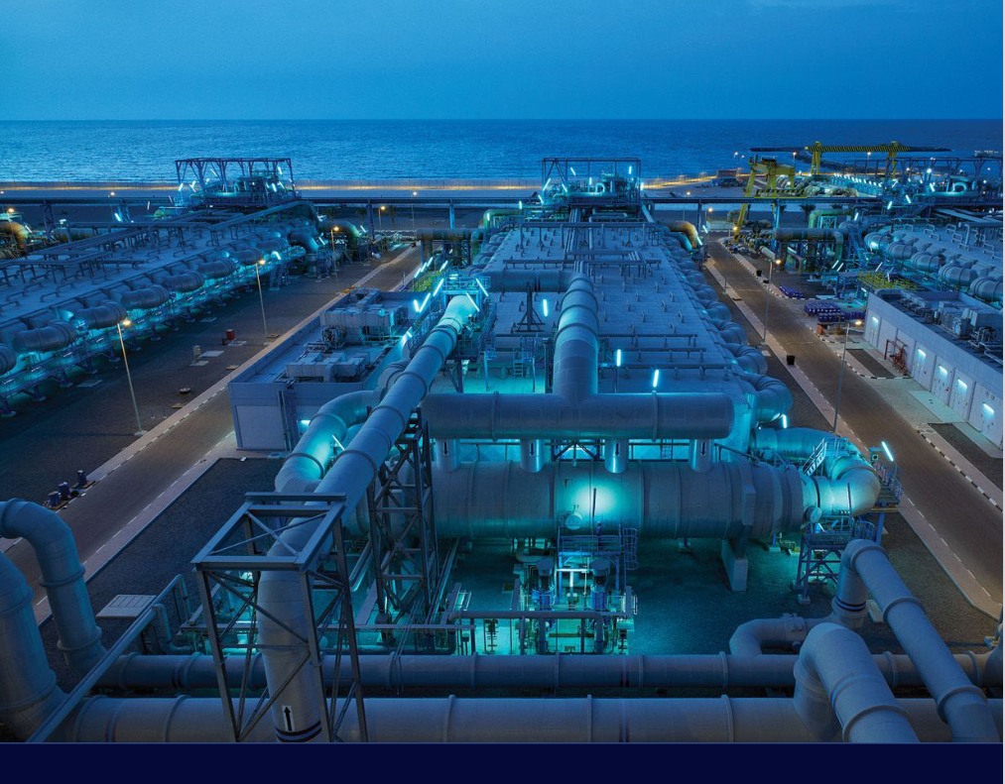
Desalination

Slide 2
Desalination Technologies
Desalination is the artificial process of removing salt from seawater in order to supply drinkable water to consumers.
Notable countries using desalination techniques include:
Australia Kuwait Saudi Arabia (60% of water supply)
China India Israel (75% of water supply)
Singapore Spain United Arab Emirates
Japan

Slide 3
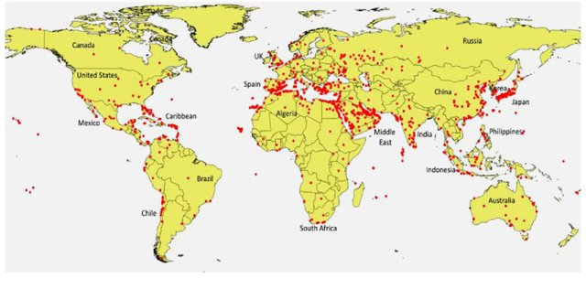
Global distribution of major desalination plants (circle dots) as of 2014.

Slide 4
Reverse Osmosis Technology
This is the salt brine that is dumped back into the ocean
Pretreatment involves adding various chemicals and removing silt, algae, seashells, sewage, and other impurities
The feed water is normally ocean The high pressure pump forces
water drawn into the plant the treated salt water through thin
membranes that block salt, leaving
fresh water on one side (product water) and salt on the other
The water at this point must be treated again with minerals and chemicals to make the water palatable. Without this the water tastes unpleasant
The energy needed to move water through the system, especially running the high pressure pumps take a lot of fossil fuels. Solar energy desalination plants are a possibility, but those plants are relatively small at this time.

Slide 5
It is ironic that the U.S. was once the pioneer in the field, but now lags behind.
After WWII, the U.S. government believed that water shortages were going to become increasingly problematic in the U.S. President John F. Kennedy began advocating the idea of large-scale desalination plants. Encouraged by public interest in desalination, researchers at UCLA began developing the first reverse osmosis membrane and in 1959, a dependable membrane hit the market. Over the years, the membranes that water was forced through improved in terms of durability and low cost. The U.S. was the pioneer of desalination technology, but not the pioneer of actually implementing desalination.
The U.S. used desalination technology as a type of “foreign aid” to countries in the Middle East, hoping to steer oil-producing countries to supply oil to the U.S., rather than Russia.
Environmental scientists are always pointing out how interconnections between organisms in ecosystems, but rarely do they mention interconnections between technology development, politics, etc.

Slide 6
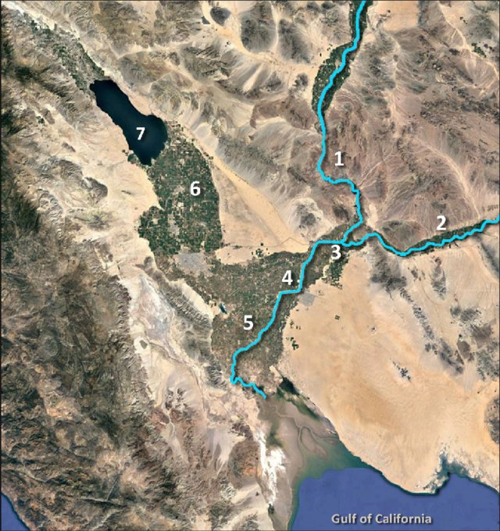
Yuma, AZ and desalination of the Colorado River Water -1993
Figure 1. Overview map. (1) Colorado River; (2) Gila River; (3) Yuma, AZ; (4) approximate path of the modern, controlled Colorado River's channel through the lower delta (where the channel is mostly dry today); (5) lower delta region below the crest; (6) Imperial Valley in the Salton Basin; (7) Salton Sea.
Yuma’s desalination plant that some of you might be familiar with, was not built to supply fresh water to the residents of Yuma, but to supply fresh Colorado River water to Mexico. It was a failing attempt to keep the peace over water rights treaties.
This story is an interesting one since it ties in with greater water use from the Colorado and treaty-making – another subfield in environmental science

Slide 7
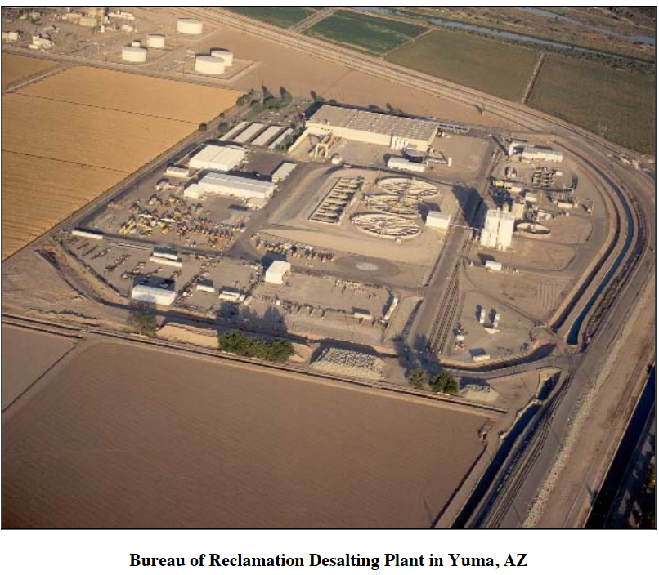
In 2010, the Central Arizona Project, Metropolitan Water District, and the Southern Nevada Water Authority partnered with the Bureau of Reclamation to finance a pilot run of the mothballed Yuma Desalting Plant, which was originally built to provide treaty-acceptable water to Mexico.
The plant was started up just to see if it would still work. It did, everyone clapped their hands, and then the plant was shut down again. The plant has round-the-clock employees checking switches and dials, while security patrols the grounds. One of the problems the plant ran into was the extreme saltiness and silt in the water that fouled up the membranes of the reverse-osmosis machinery.

Slide 8
Technological innovation isn’t always a solution to environmental problems
Desalination is 25 times more energy intensive compared to other freshwater approaches, which partly accounts for its high cost. If the process relies on fossil fuels, it contributes to the release of greenhouse gases, which only magnifies the arid conditions that make desalting necessary to begin with. In Saudi Araba, approximately 1.5 million barrels of oil are consumed per day for desalination. This is a deeply unsustainable consumption of water that seems “free” to consumers.
What to do with all of that salt? The sea water around Saudi Arabia is now 25% saltier than normal sea water due to salt disposal back out to sea. The water will eventually become so saline that it will become too expensive to desalinate (like the Yuma desalination plant).
Where do you site a desalination plant in the U.S.? Many of America’s shorelines are protected or heavily developed. Many agencies−−federal, state county, and city must approve the siting along with the EPA. This can take years. Maybe desalination plants will be developed offshore.

Slide 9
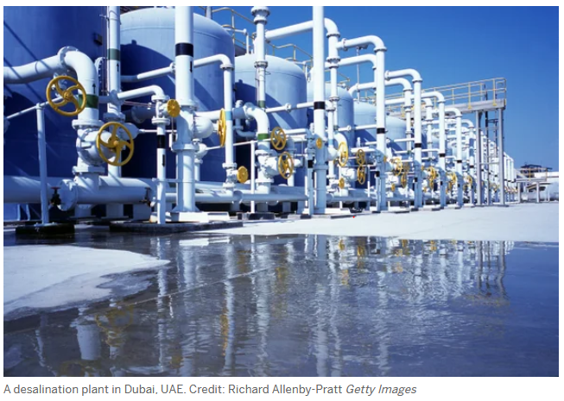
Waste Product and Other Environmental Concerns
Aside from the energy and maintenance costs, another serious concern with the desalination plants is what to do with the main waste product, brine. The most common disposal method for brine worldwide is to discharge it directly back to where it came from. The concern with this practice is that the higher salinity of brine causes it to be denser than the source water, so when brine is discharged directly into oceans it can form “brine underflows,” where layers of extra salty solution spread across the seafloor. With time, the brine underflows deplete the ocean bottom of dissolved oxygen.
The high salinity and reduced oxygen levels cause habitat degradation, particularly for bottom-dwelling organisms, which can in turn lead to a reduction in the numbers of deep-living bacteria, phytoplankton, invertebrates, and fish communities.
Therefore, the release of brine directly into coastal and marine waters can reduce water quality and endanger the fragile ecosystem.

Slide 10
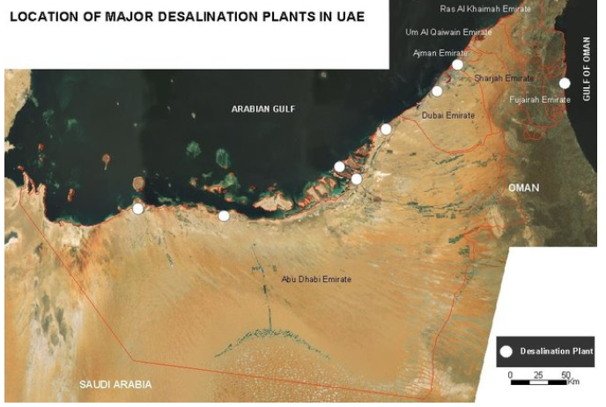
Here you can see the locations of large desalination plants in the United Arab Emirates. This is practically the only way that residents can obtain fresh water. The Arabian Gulf and the Gulf of Oman supply the sea water to the plants where the salt and silt and chemicals are removed.
The salt and silt that are removed are placed on ships and dumped back into the Arabian Gulf and Gulf of Oman. The Arabian Gulf is 25% saltier than it was in the 1950s!
This has impacts on organisms living in the sea water – they are adapted to living in water with increased salt in it, but how well are they adapted to living in water that is double or tripled in salt?

