Slide 1
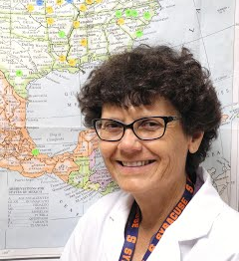
There's a World Out There: Using Biointeractive Resources to Help Internationalize Microbiology Education
Karen Wellner, PhD Chandler Gilbert Community College
2020-2022 International Studies Fellow
University of Arizona Center for Middle Eastern and Latin American Studies
BIO 205 Microbiology

Slide 2
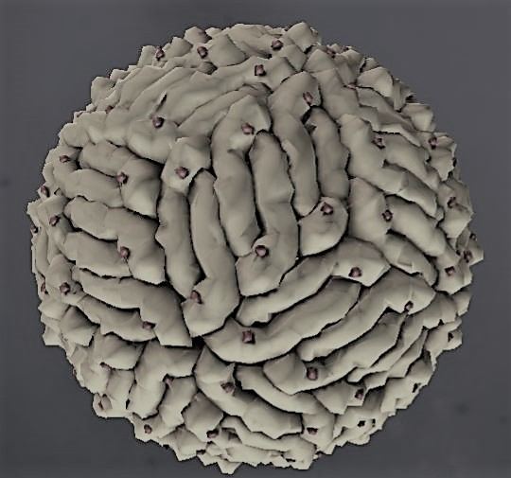
Neotropical Diseases (NTDs) and Latin America
Biointeractive Resources
NTDs are a significant public health burden, affecting over one billion people globally, yet tropical disease has been similarly marginalized in the biology classrooms despite offering an opportunity to teach about a diverse area of microbiology with far-reaching public health, social, and economic implications.
PRE-SURVEY
Here we are in 2022 with many medical technology and infectious disease prevention tools available to us. Why then are people around the world still dying from infectious disease?
RESPONSES (ranked)
· low income/isolated areas/lack of infrastructure
· organisms mutate or “get stronger”
· uneducated/unawareness/ignorance/personal hygiene
Virus Explorer
The Mosquito Life Cycle
Malaria: Human Host
Malaria: Mosquito Host
Dengue Fever

Slide 3
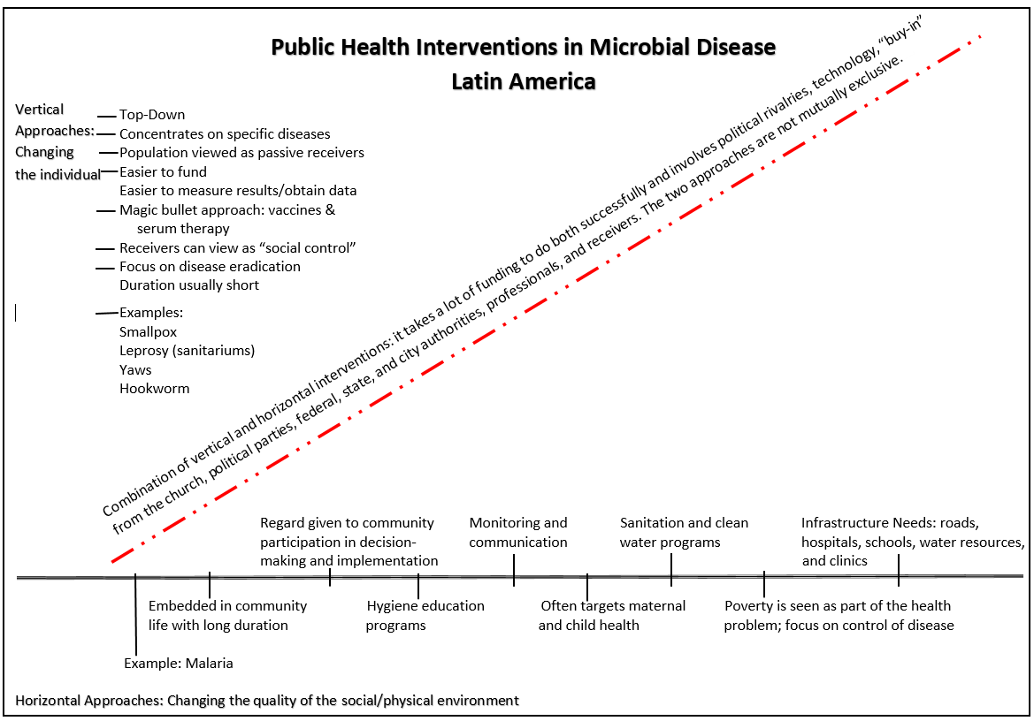

Slide 4
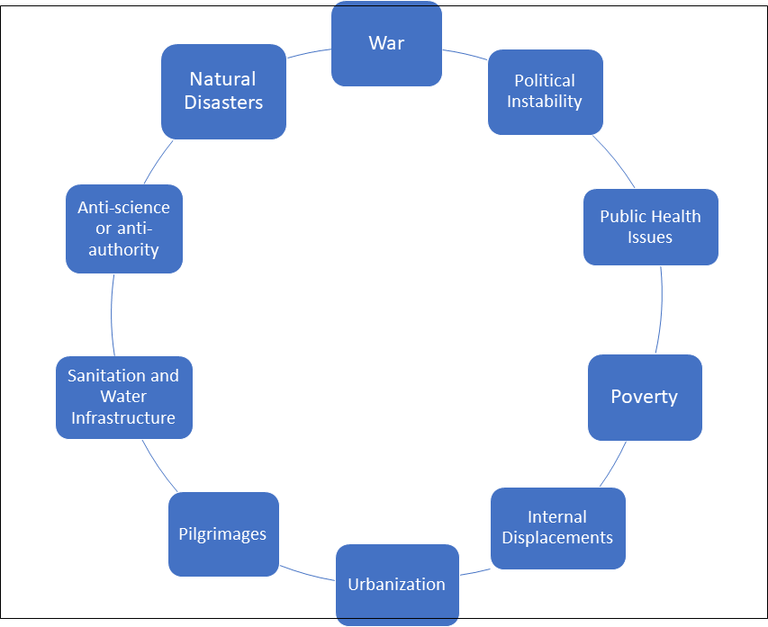
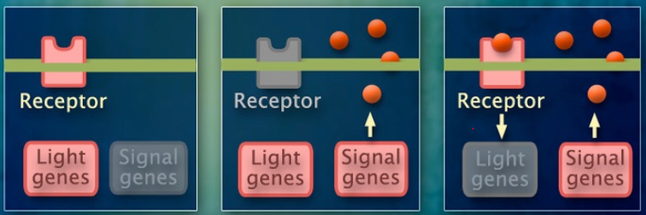
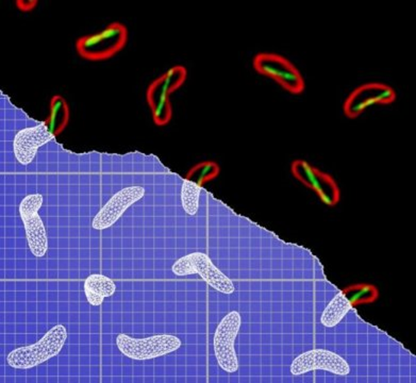
Cholera in the Middle East and North Africa (MENA)
Biointeractive Resource: Bacterial Quorum Sensing + revisions
Class-generated cholera risk factors from primary sources

