Slide 1
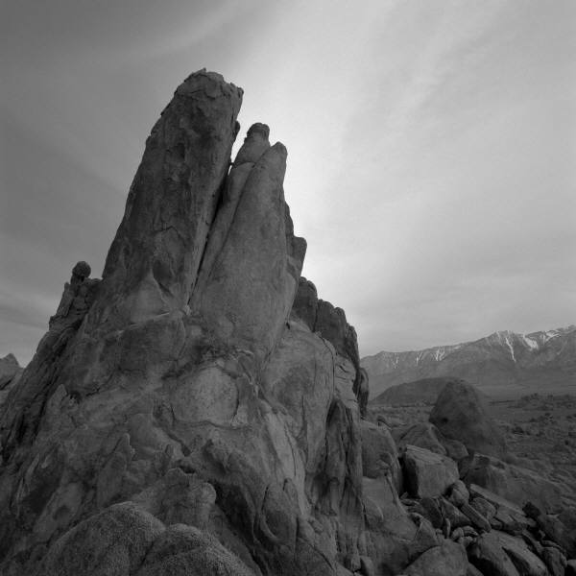
country

Slide 2
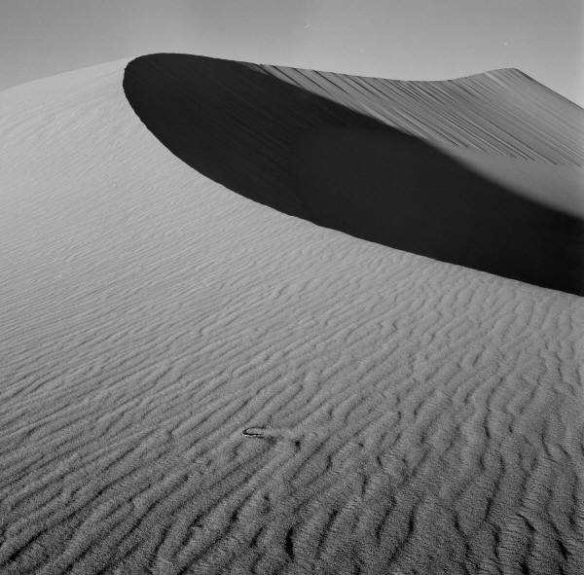
Where is it?
It is in…

Slide 3
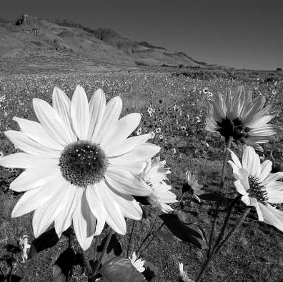
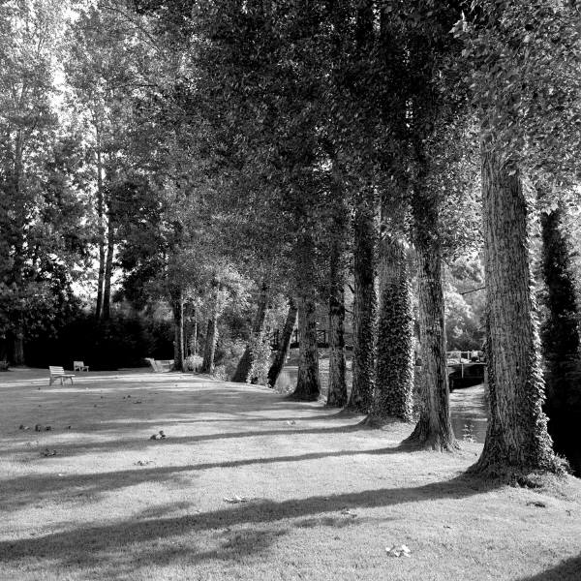
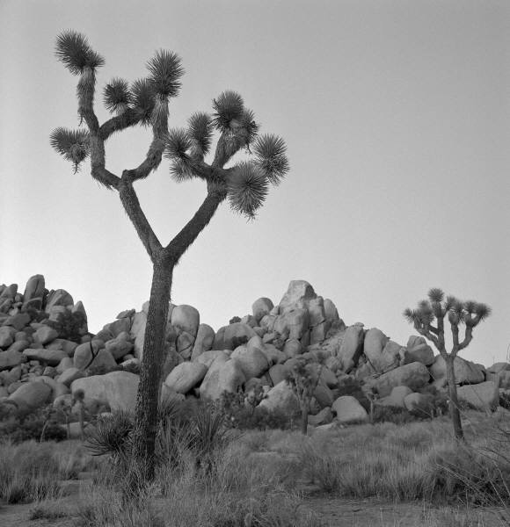
REFUGEES 2015 AND 2016
How many refugees has this country accepted in recent years? Where are they from?
_____ accepted ____ (#) refugees in (year). They are from _____.

Slide 4
refugees
How many total refugees live in the country?
_________ refugees live in the country.

Slide 5
POPULATION
What is the total population of the country?
The total population is …

Slide 6
GROSS DOMESTIC PRODUCT
What is the current GDP?
The GDP per capita, or per person, is approximately_____.

Slide 7
